Slide 1
Requirement Evolution and Prioritization
Requirement Evolution
Evolution Process
Necessity of Requirement Evolution
Requirement Prioritization & Need for it
Things to Note First
Techniques of Requirement Prioritization
Benefits of Prioritization
Prioritization Process
Aspects of Prioritization
Methods of Prioritization

Slide 2
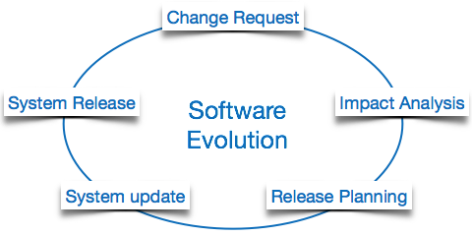
Requirement Evolution
Evolution of requirements refers to changes that take place in a set of requirements after initial requirements engineering phase. Thus changes in requirements that may happen in initial elicitation, analysis, specification and validation phases are not evolutionary.
Changes in requirements are additions, omissions or modifications of requirements.
The cost and impact of these changes are accessed to see how much system is affected by the change and how much it might cost to implement the change. If the proposed changes are accepted, a new release of the software system is planned.
Evolution Process
Change Analysis
Release Planning
System Implementation
Deployment

Slide 3
Necessity of Requirement Evolution
Following grounds describe the necessity of requirement evolution;
1- Change in Requirement with Time
The organization’s needs and methods of working could significantly change with the passage of time.
So in this frequently changing time, the software that they are using need to change for maximize the performance.
Example
1) Introduction of anchor points in Adobe illustrator.
2) Development of illustrator CS6 into illustrator CC.

Slide 4
2- Environment Change
As the working environment changes the things(tools) that enable us to work in that environment also changes proportionally same happens in the software world as the working environment changes then, the organizations need reintroduction of old software with updated features and functionality to adapt the new environment.
Examples
1) Upgradation of Operating System
2) Development of Compilers for Programming Languages

Slide 5
3- Errors and Bugs
As the age of the deployed software within an organization increases their preciseness or impeccability decrease and the efficiency to bear the increasing complexity workload also continually degrades. So, in that case, it becomes necessary to avoid use of obsolete and aged software.
All such obsolete Software need to undergo the evolution process in order to become robust as per the workload complexity of the current environment.
Examples
1) VS code for C++
2) Pycharm for Python

Slide 6
4- Security Risks
Using outdated software within an organization may lead you to at the verge of various software-based cyberattacks and could expose your confidential data illegally associated with the software that is in use.
So, it becomes necessary to avoid such security breaches through regular assessment of the security patches/modules are used within the software.
If the software isn’t robust enough to bear the current occurring Cyber attacks so it must be changed.
Examples
1) Special Characters in Password
2) Biometric or Two-Step Verification

Slide 7
5- New Functionality and Features
In order to increase the performance and fast data processing and other functionalities, an organization need to continuously evolution the requirement throughout its life cycle so that stakeholders & clients of the product could work efficiently.
Addition of new features due to user demands.
Examples
1) Video option on follower’s comment in Snack app
2) Separation of chats and groups messages in GB WhatsApp.

Slide 8
Requirement Prioritization & Need for it
Requirements prioritization means giving precedence to some requirements over other requirements based on feedback from system stakeholders.
Some time you don’t deliver the whole system at once, you deliver the system in iterations.
Now the next thing you must cope with, what are the features which client want at early level.
What are the features you can provide at early level.
Sometime the client demand which is not possible at early stage some features are dependent on other.
So you make some criteria and prioritize the things you will provide at early level.

Slide 9
For Example:
We go to buy a smartphone, there are lots of smartphones available in the market with features some smartphones have good camera but do not have good battery timing sometime a smartphone provide you good battery timing but may be there is a lack of good camera so you have to compromise your beautiful selfie.
So this is the point you will take a prioritization-based decision either the camera is important for you or the battery timing matters for you.
If you are a working guy you will compromise the camera and go for long lasting battery you take the decision and prioritize the battery based on your need.

Slide 10
Things to Note First when Prioritizing the Requirements
May be the most important functionality will not be the first prioritization because it is expensive, and the lack of budget is the client- side problem.
Possibly there will be more than one Software stakeholders and different stakeholders have different priorities sometime.
Keep in mind the simple rule, As a requirement engineer you have to prioritize the requirement under the constraints by the feedback of stakeholders.

Slide 11
Techniques of Requirement Prioritization
Negotiation Technique:
In this technique, requirement engineer will work with the stakeholder, clients and all other who will be the user of the software collect the requirements, get feedback on the requirements negotiate with customer e.g. what you want to provide the first , or agree them what is better for them to get in start of the software.
Quantitative Technique:
In this technique requirement engineer should perform an analysis based on quantities e.g. what is the budget of client for first feature needed in software?
In how much time the client want the working software?
What are the financial benefits? What are the risks?
How much level of risk we can bear on the current level.

Slide 12

Requirements Prioritization:
“ The process of managing the relative importance and urgency of different requirements to cope with the limited resources of projects “

Slide 13
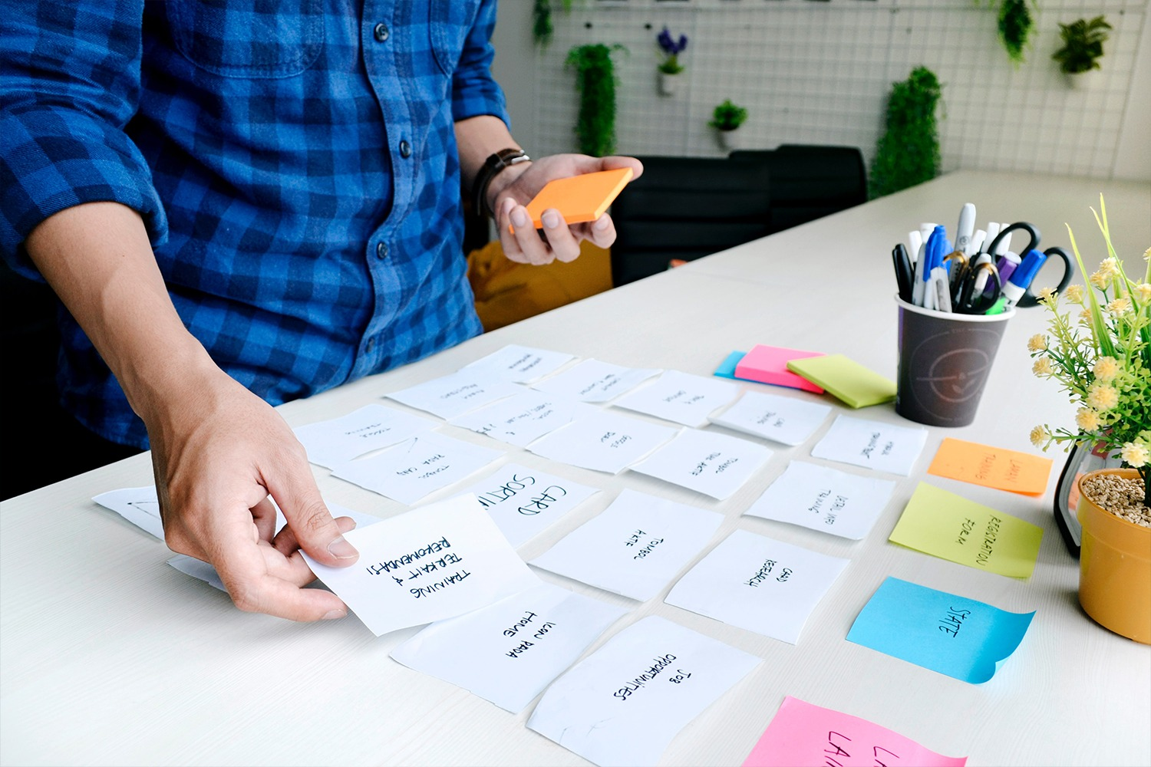
Benefits:
Less rework
Fewer defects in requirements and in the delivered product
Fewer unnecessary functions
Faster development
Higher customer and developer satisfaction
Reducing the expectation gap

Slide 14
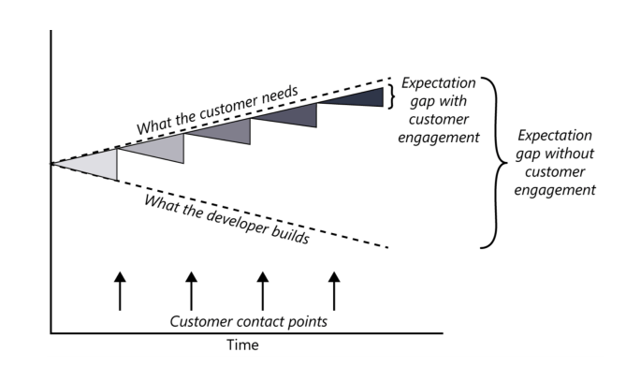
Frequent customer engagement reduces the expectation gap.

Slide 15

Benefits:
Ordered, optimal set of software requirements
Trade-off the conflicts as schedule, time, budget and quality
Implications on software architecture
Future evolution and it’s associated cost.
Technical advantage
Optimize market opportunity
Plan stability(minimize schedule slippage)
Negotiation process
provide the greatest value at the lowest cost

Slide 16

Prioritization Process:
Prioritization is the process by which a set of items are ranked in order of importance.
This is an iterative process and might be performed at different abstraction levels and with different information in different phases during the software lifecycle.
Roughly Divided into 2 categories:
Methods
Negotiation approach

Slide 17

Aspects of Prioritization:
Importance
Penalty
Cost
Time
Risk
Volatility
Other Aspects(Financial benefit, strategic benefit, competitors, competence/resources, release theme, ability to sell)

Slide 18
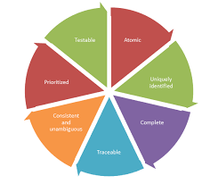
There are a number of prioritization methods commonly used by product managers, such as:
Kano Model
Weighted Scoring
Opportunity Scoring
MoSCoW
Value vs. Complexity

Slide 19
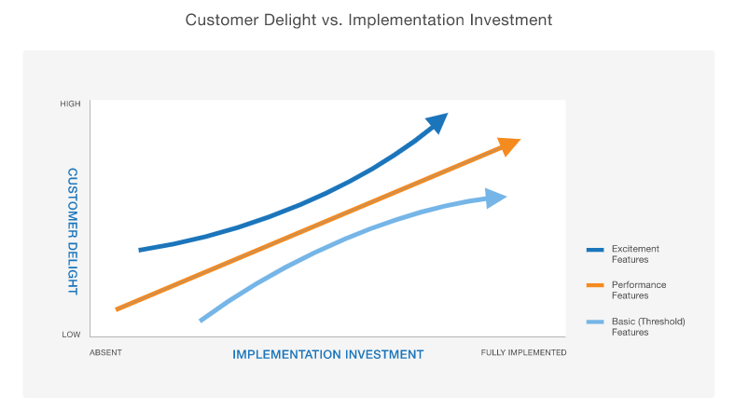
Kano Model
The team will weigh the features according to two competing criteria:
Their potential to satisfy customers.
The investment is needed to implement them.

Slide 20
Weighted Scoring
In a product context, weighted scoring prioritization works as follows.
Step 1: Compile a list of the features and other initiatives under consideration.
Step 2: Devise a list of criteria. This includes both costs and benefits, on which you’ll be scoring each of these initiatives.
Step 3: Determine the respective weights of each criterion you’ll use to evaluate your competing initiatives.
For example, let’s say you determine that the benefit “Increase Revenue” should be weighted significantly in the overall score than the cost “Implementation Effort.” Then you will want to assign a greater percentage of the overall score to Increase Revenue.
Step 4: Assign individual scores for each potential feature or initiative across all of your cost-and-benefit metrics. Then calculate these overall scores to determine how to rank your list of items.

Slide 21
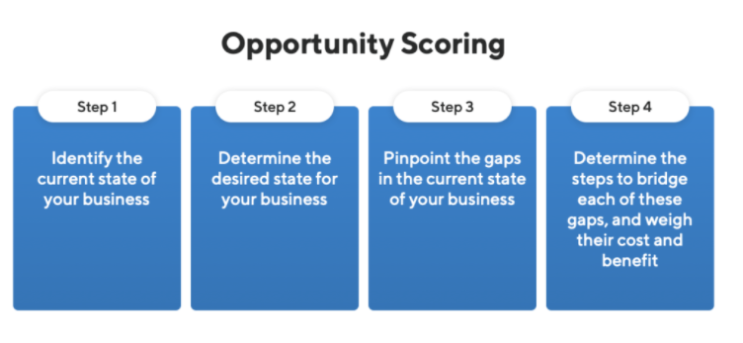
Opportunity Scoring
Product teams use this strategy when they want to learn which features customers view as important but are currently unhappy with.
Improving these features can represent opportunities for the product to win increased customer satisfaction and loyalty and also to attract new customers.
You can think of opportunity scoring as an importance-versus-satisfaction analysis.

Slide 22
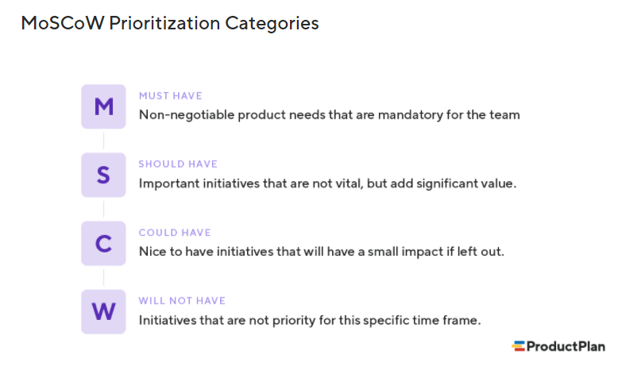
MoSCoW prioritization
MoSCoW prioritization, also known as the MoSCoW method or MoSCoW analysis, is a popular prioritization technique for managing requirements.

Slide 23
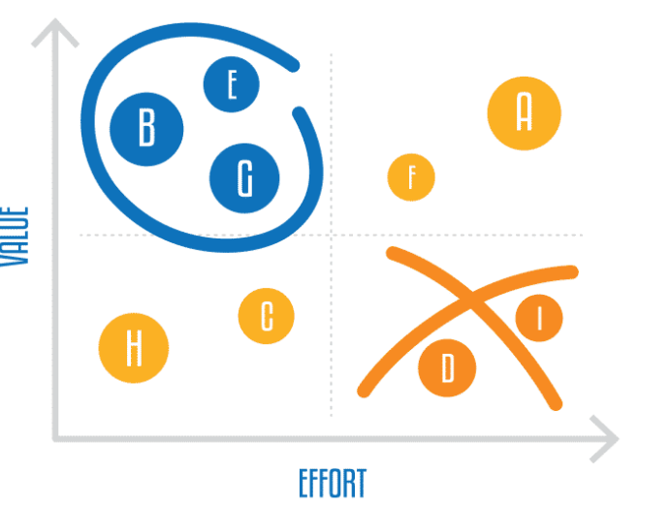
Value vs. Complexity
The model works as follows: For each initiative under consideration, the product team will make two separate assessments:
How much value it anticipates the initiative to deliver.
How much effort implementing it will require.
Method:
Determine a value score for your features
Determine a “complexity” score for each initiative

Slide 24


